Slide 1
MA415 OSHA Midterm project
Katherine Mercurio; kmerc@bu.edu

Slide 2
Phases of my tidying
Experimenting—playing around with data sets
Focusing on Osha and Viol
Adding more important columns from accid
Adding/fixing dates
Graphics

Slide 3
Experimenting (PART 1)
Tried to merge all data sets
Became too complex
Refocused goal; decided to make a smaller, more accurate picture of dangerous work places with my cleaning instead of linking everything

Slide 4
OSHA.dbf and viol.dbf (PART 2)
Libraries:
Foreign
Dplyr
Goals:
Create a new data frame linking ACTIVITYNO from both dbf files and important atttributes
Functions:
Read.dbf()
Subsetting
Distinct/unique
Join
Filter

Slide 5
Accid.DBF (PART 3)
Libraries:
Plyr
Bbmisc
Foreign
Dplyr
Goal: incorporate accid columns into data frame
Functions:
Read.dbf()
Unique
Subsetting
Join
dropNamed
rename

Slide 6
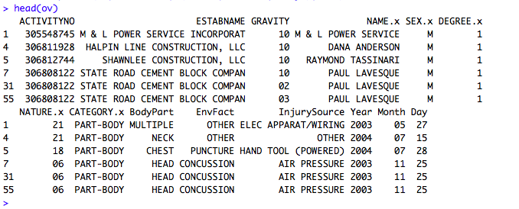
Cleaning up/adding dates (4)
Library:
Tidyr
Goal: separate issue date
Function:
Separate

Slide 7
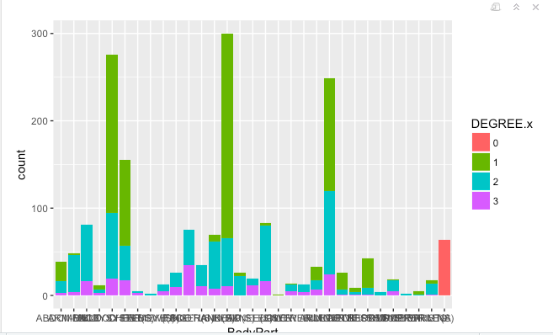
Graphics (PART 5)
Library:
Ggplot2
Graph is smooshed here because of lack of room

